Slide 1
Zhukovskiy, the cradle of Russian aviation
By: P. A. Mitin
Supervisor: E. N. Shishkina

Slide 2
Annotation
Brief history review
Great aviators of Zhukovskiy
Scientists of Zhukovskiy
“TSAGI” institute
MAKS expo

Slide 3
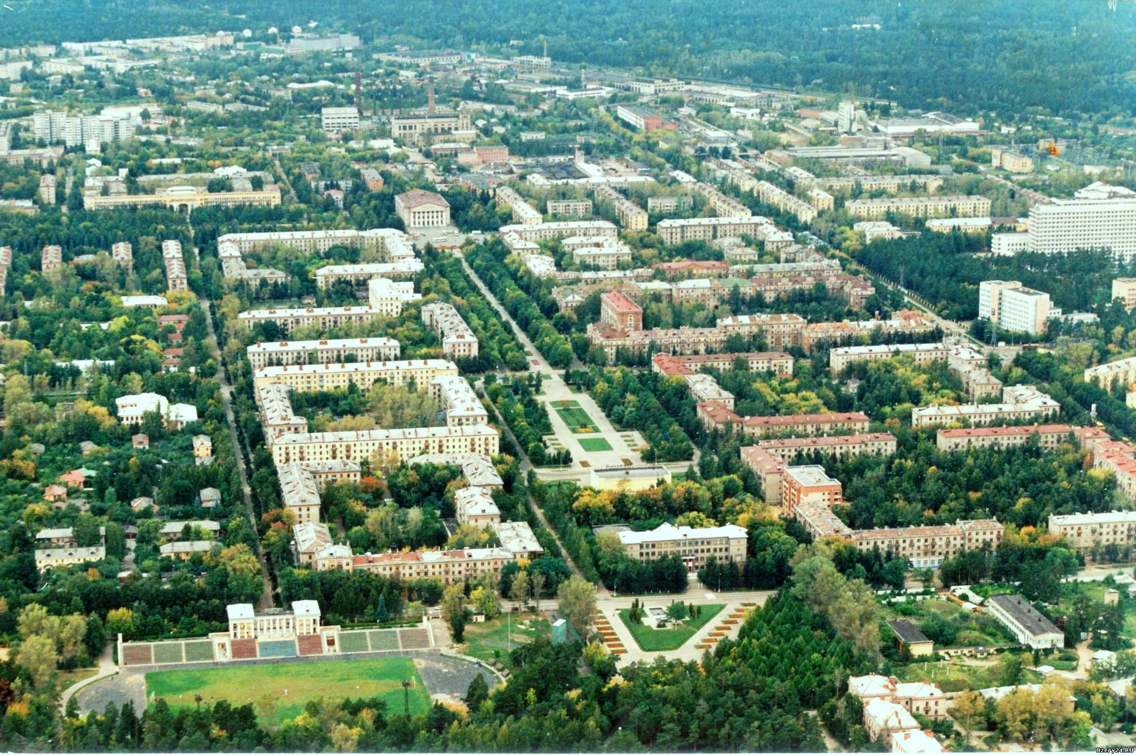
Brief history review
The city still holds the form of initial planning

Slide 4
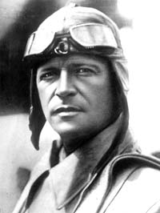
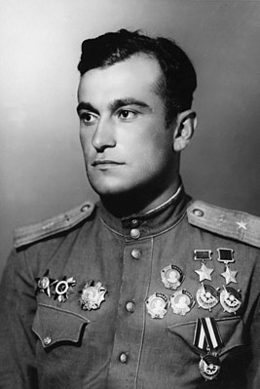
Great aviators of Zhukovskiy
Mikhail Gromov
Amet-Khan Sultan

Slide 5
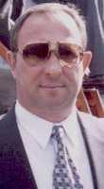
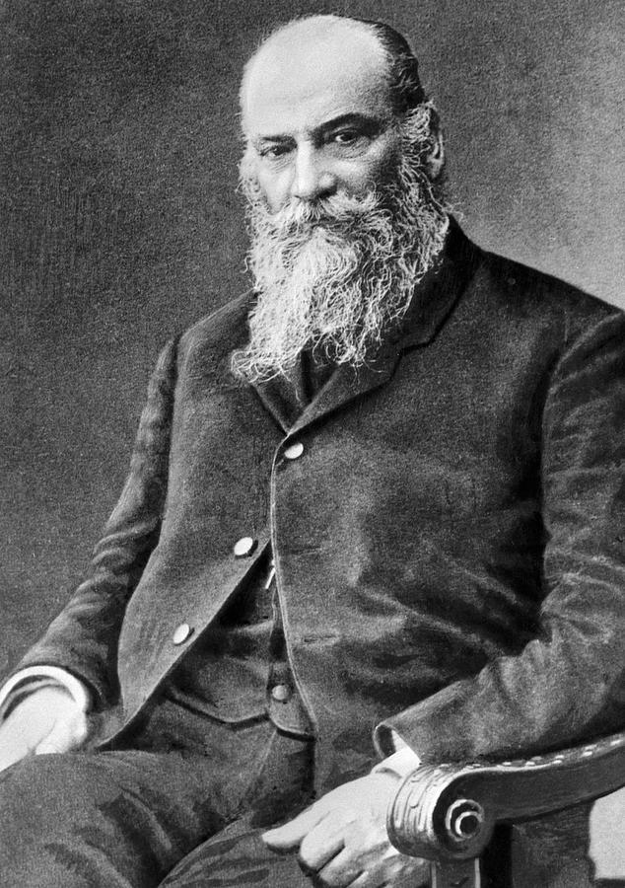
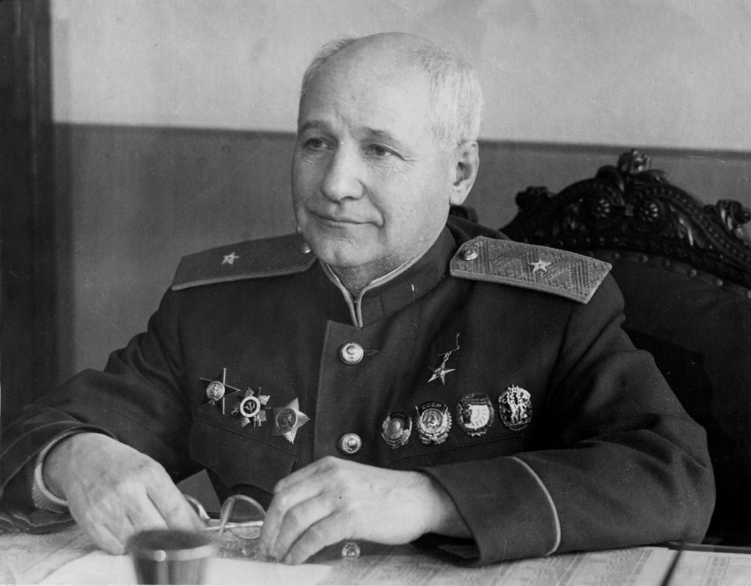
Scientists of Zhukovskiy
Nikolay Zhukovskiy
Andrey Tupolev
Mikhail Korzhuev

Slide 6
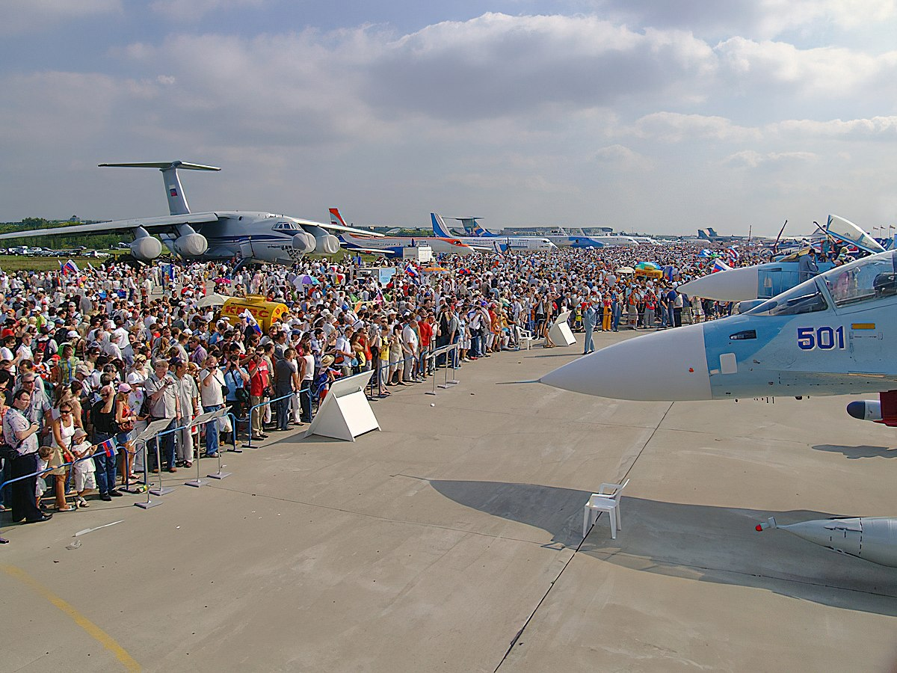

MAKS expo
MAKS expo is held every odd year in Zhukovskiy

Slide 7
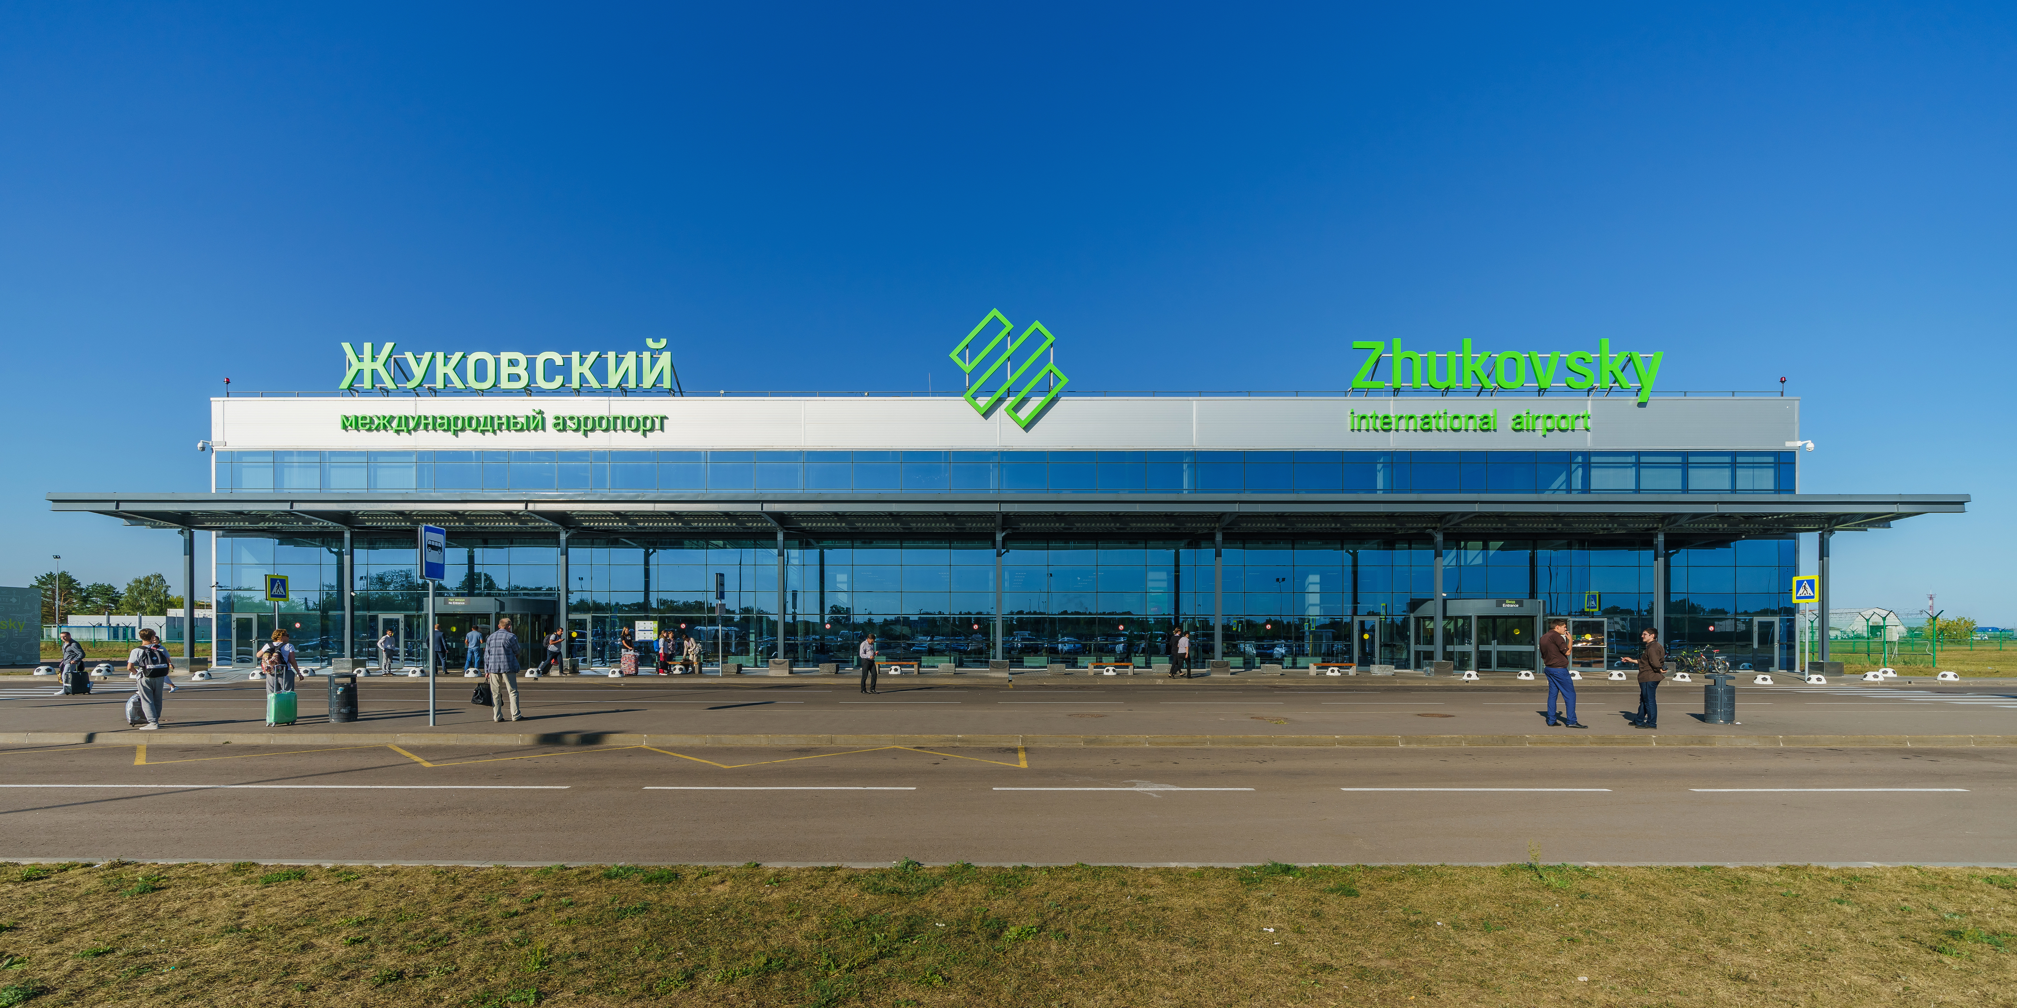
Zhukovskiy airport
The building of Zhukovskiy airport

Slide 8
Thank You for Your Attention

